Slide 1
Example 1: Pass Individual Array Elements
#include <stdio.h>
void display(int age1, int age2) {
printf("%d\n", age1);
printf("%d\n", age2);
}
int main() {
int ageArray[] = {2, 8, 4, 12};
// pass second and third elements to display()
display(ageArray[1], ageArray[2]);
return 0;
}

Slide 2
Example 2: Pass Arrays to Functions
// Program to calculate the sum of array elements by passing to a function
#include <stdio.h>
float calculateSum(float num[]);
int main() {
float result, num[] = {23.4, 55, 22.6, 3, 40.5, 18};
// num array is passed to calculateSum()
result = calculateSum(num);
printf("Result = %.2f", result);
return 0;
}

Slide 3
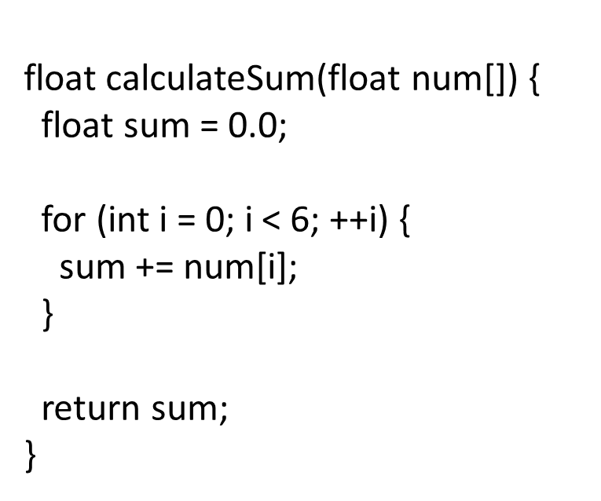

Slide 4
O/P 24 56 23 4 41 19
#include <stdio.h>
void myfun(int[]);
int main()
{ int num[] = {23, 55, 22, 3, 40, 18};
myfun(num);
for (int i = 0; i < 6; ++i) { printf("%d\t",num[i]);
} return 0;
}
void myfun(int num[])
{
for (int i = 0; i < 6; ++i)
{ num[i]++;
} return;}

Slide 5
O/P 24 56 23 4 41 19
#include <stdio.h>
void myfun(int[]);
int main()
{ int num[] = {23, 55, 22, 3, 40, 18};
myfun(num);
for (int i = 0; i < 6; ++i) { printf("%d\t",num[i]);
} return 0;
}
void myfun(int num1[])
{
for (int i = 0; i < 6; ++i)
{ num1[i]++;
} return;
}

Slide 6
Example 3: Pass two-dimensional arrays
#include <stdio.h>
void displayNumbers(int num[2][2]);
int main() {
int num[2][2];
printf("Enter 4 numbers:\n");
for (int i = 0; i < 2; ++i) {
for (int j = 0; j < 2; ++j) {
scanf("%d", &num[i][j]);
}
}
// pass multi-dimensional array to a function
displayNumbers(num);
return 0;
}
void displayNumbers(int num[2][2]) {
printf("Displaying:\n");
for (int i = 0; i < 2; ++i) {
for (int j = 0; j < 2; ++j) {
printf("%d\n", num[i][j]);
}
}
}

Slide 7
#include <stdio.h>
// function to print array
void printArray(int arr[], int size)
{
printf("Array Elements: ");
for (int i = 0; i < size; i++) {
printf("%d ", arr[i]);
}
}
// driver code
int main()
{
int arr[8] = { 12, 4, 5, 3, 7, 8, 11, 45 };
// getting the size of array
int size = sizeof(arr) / sizeof(arr[0]);
printArray(arr, size);
return 0;
}

Slide 8
Printing Array of Characters (String) using Function
#include <stdio.h>
// function to print the string
void printString(char str[])
{
printf("Array of Characters: ");
int i = 0;
while (str[i] != '\0') {
printf("%c ", str[i]);
i++;
}
}
// Driver program
int main()
{
char arr[] = "String";
printString(arr);
return 0;
}

Slide 9
C - Recursion
Recursion is the process of repeating items in a self-similar way. In programming languages, if a program allows you to call a function inside the same function, then it is called a recursive call of the function.
void recursion()
{ recursion(); /* function calls itself */
}
int main()
{ recursion(); }

Slide 10
Number Factorial
#include <stdio.h>
int factorial(int i)
{
if(i <= 1)
{
return 1;
}
return i * factorial(i - 1);
}
int main()
{
int i = 12;
printf("Factorial of %d is %d\n", i, factorial(i));
return 0;
}

Slide 11
Fibonacci Series
#include <stdio.h>
int fibonacci(int i)
{
if(i == 0)
{ return 0; }
if(i == 1) { return 1; }
return fibonacci(i-1) + fibonacci(i-2); }
int main()
{ int i;
for (i = 0; i < 10; i++)
{ printf("%d\t\n", fibonacci(i)); }
return 0; }

